Slide 1

Automobile Engine Fault Diagnosis Using Machine Learning Method
School of Mechanical & Control Engineering
Handong Global Univ.
Oct.22.2024
Industrial AI & Automation
Project 1
Prof. Young-Keun Kim
21900416 An Gyeonheal
21900727 Jin Garam

Slide 2
CONTENTS
1. Proposal Review
2. Baseline Journal Implementation
3. Data Preprocessing
4. Classification Model Improvement
5. Result & Discussion
6. Additional Research – BOSCH Engine Datasets

Slide 3
1. Proposal Review

Slide 4

1. Proposal Review
- Objective -
By Developing a Model that Outperforms those Implemented in Existing Journals,
Accurately Identify types of Engine faults, Providing Greater Speed and Precision in Engine Repairs.
- Goal -
A machine learning model that diagnoses 4 types of defects using 14 input variables.
Over the Journal F-1 Score (≥ 75.1% )
- Expected Effective -
By building a model capable of early diagnosis of automotive defects, expect positive effects on time, cost, and safety.
By Applying Machine Learning, Classification to Identify Types of Engine Faults.
Quickly Diagnose and resolve Engine Faults, Enabling Fast, and Efficient Repairs.
[1] Vergara, M., Ramos, L., Rivera-Campoverde, N. D., & Rivas-Echeverría, F. (2023). Enginefaultdb: a novel dataset for automotive engine fault classification and baseline results. IEEE Access, 11, 126155-126171.

Slide 5
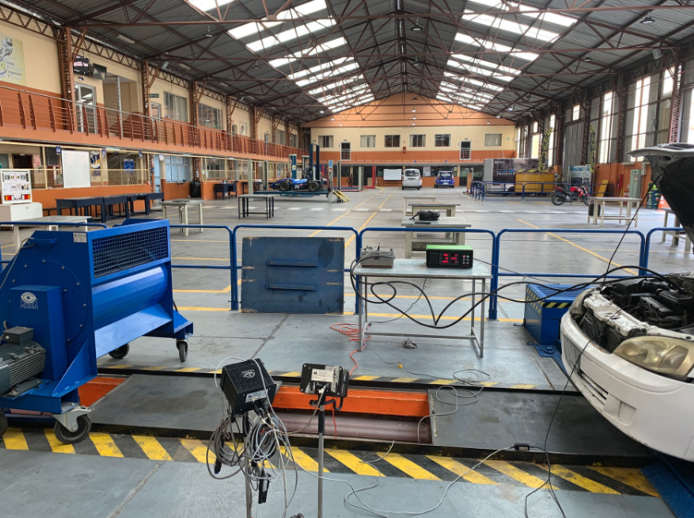
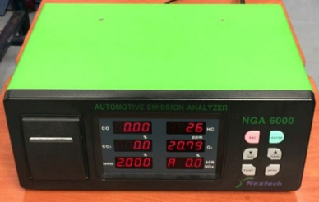
1. Proposal Review
- Data Sets Name-
EngineFaultDB (Supervised Learning)
- Acquisition -
DAQ, Gas Analyzer
<Engine Data Collection / Gas Analyzer Device>
- Input -
- Output -
MAP, TPS, Force, Power, RPM, Consumption(L/H), Consumption(L/100), Speed, CO, HC, CO2, O2, Lambda, AFR
Fault type 0: Normal (16,000 entries)
Fault type 1: Rich mixture - High Pressure, Incorrect Sensor, etc. (10,988 entries)
Fault type 2: Lean mixture – Low Pressure, Incorrect Sensor, etc. (15,000 entries)
Fault type 3: Low Voltage – Worn Spark, Defective Coil, etc. (14,001 entries)

Slide 6
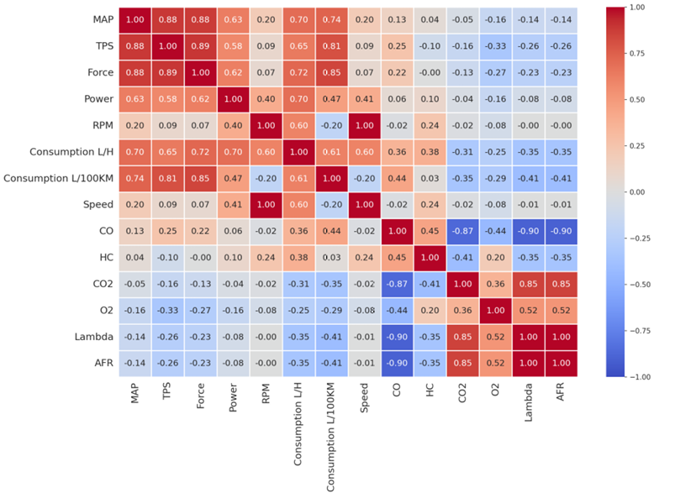
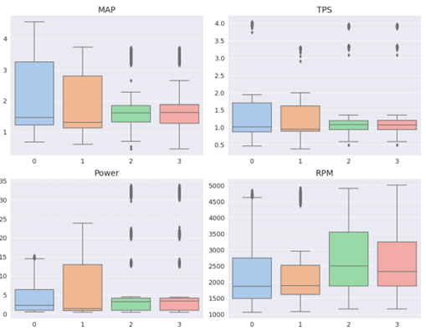
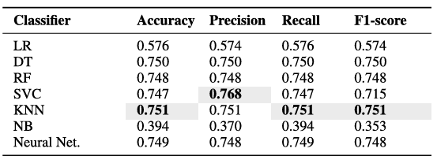
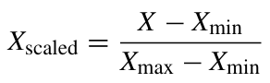
1. Proposal Review
- How Baseline Journal did-
< Journal Performance >
Best Model Performance
of Baseline
→ 75.1%
1. Correlation Analyze
2. Tendency & Outlier
3. Min-Max Scaling

Slide 7
2. Baseline Journal Implementation

Slide 8
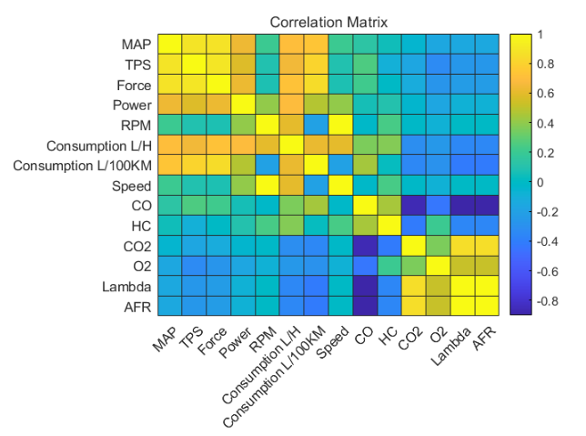
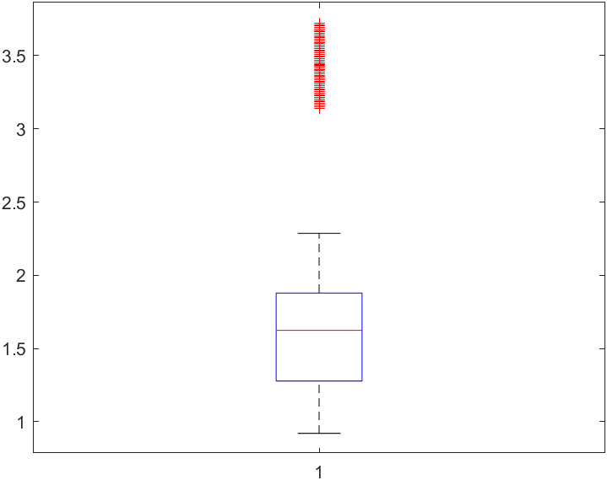
2. Baseline Journal Implementation
Following Journal’s Method in MATLAB
< Correlation Analysis >
< Box Plot Analysis>
Identified trends using a correlation table.
A box plot examines the distribution of outliers.

Slide 9
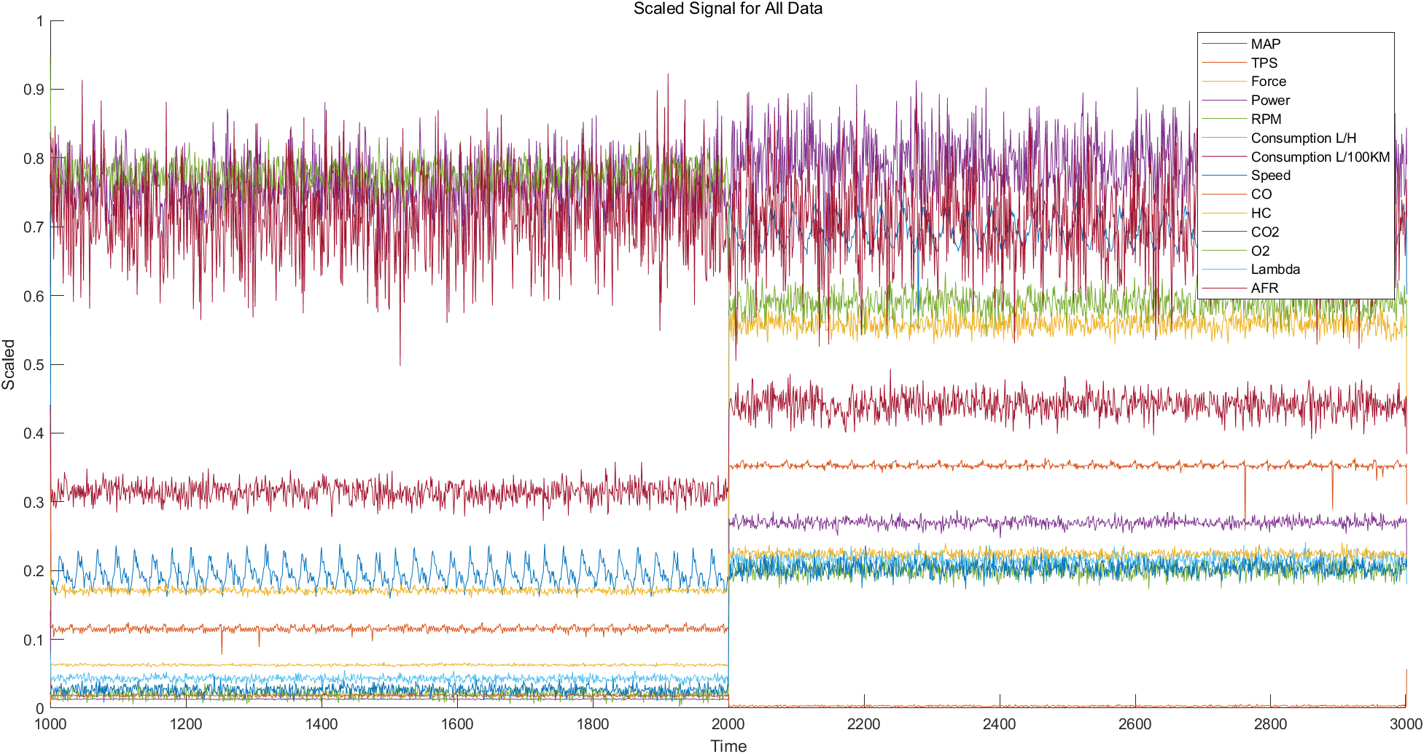
2. Baseline Journal Implementation
Following Journal’s Method in MATLAB
 | SVM | TREE | KNN | LR
Accuracy | 0.59 | 0.74 | 0.75 | 0.48
Precision | 0.58 | 0.75 | 0.76 | 0.48
Recall | 0.59 | 0.75 | 0.76 | 0.50
F1 Score | 0.57 | 0.75 | 0.76 | 0.48
< Min-Max Scaling >
< Performance >
Applied min-max scaling to ensure effective training.
Achieved similar outcomes to those reported in the paper.

Slide 10
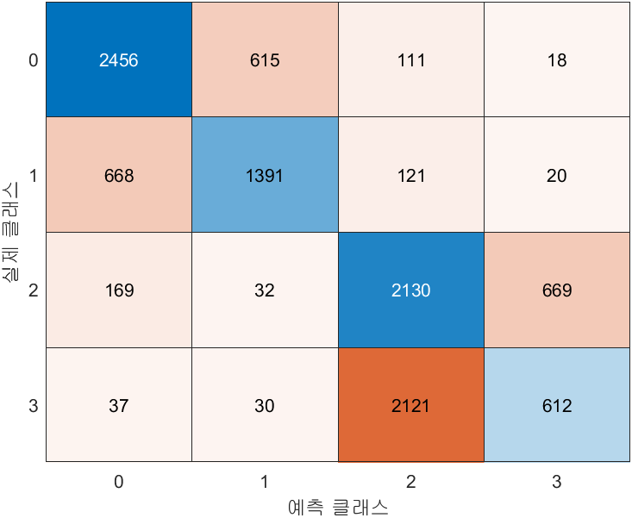
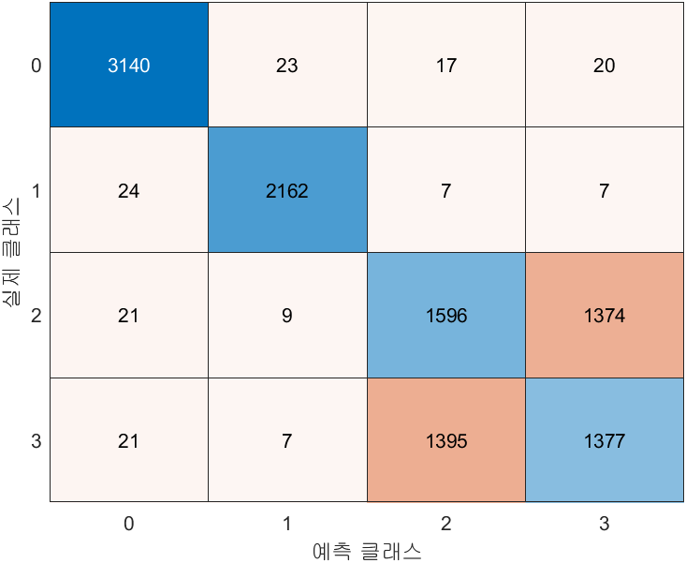
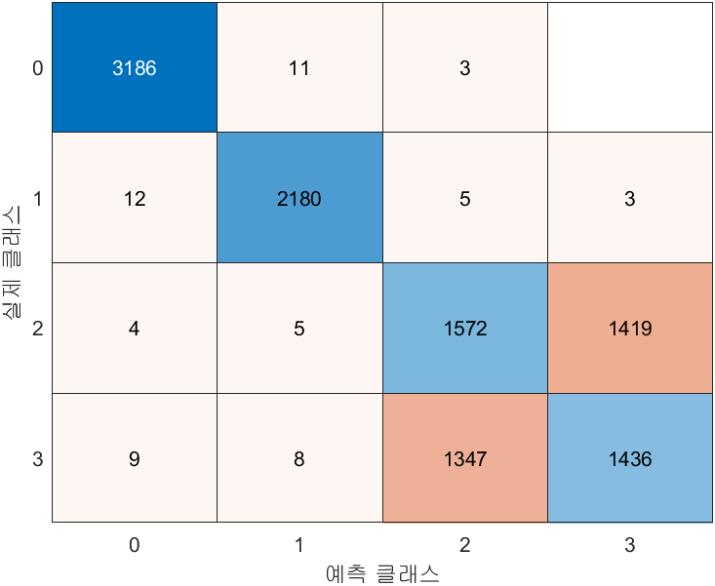
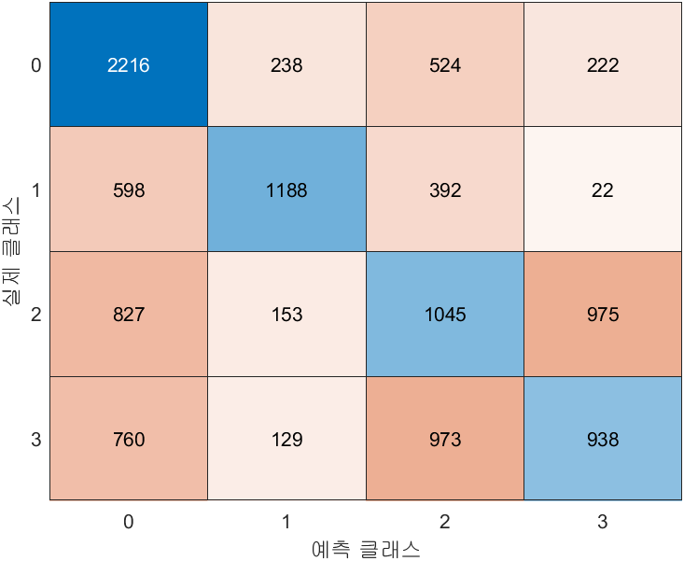
2. Baseline Journal Implementation
< Journal Performance >
SVM
TREE
Almost Same!!
< Following Journal Performance >
 | SVM | TREE | KNN | LR
Accuracy | 0.59 | 0.74 | 0.75 | 0.48
Precision | 0.58 | 0.75 | 0.76 | 0.48
Recall | 0.59 | 0.75 | 0.76 | 0.50
F1 Score | 0.57 | 0.75 | 0.76 | 0.48
KNN
Logistic Regression
< Follow Journal Performance >

Slide 11
2. Baseline Journal Implementation
TREE
How can we develop the performance?
SVM
X
< Performance >
 | SVM | TREE | KNN | LR
Accuracy | 0.59 | 0.74 | 0.75 | 0.48
Precision | 0.58 | 0.75 | 0.76 | 0.48
Recall | 0.59 | 0.75 | 0.76 | 0.50
F1 Score | 0.57 | 0.75 | 0.76 | 0.48
Feature Extraction / Feature Reduction / Selecting Features
KNN
Logistic Regression
Why?

Slide 12
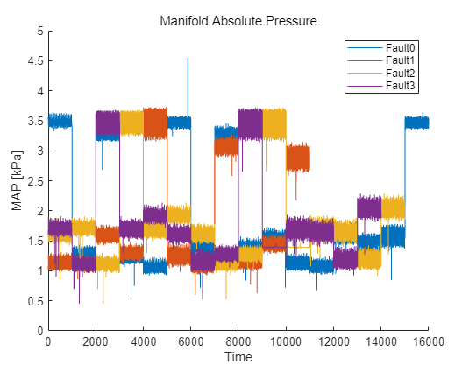
2. Baseline Journal Implementation
SVM
TREE
< Performance >
 | SVM | TREE | KNN | LR
Accuracy | 0.59 | 0.74 | 0.75 | 0.48
Precision | 0.58 | 0.75 | 0.76 | 0.48
Recall | 0.59 | 0.75 | 0.76 | 0.50
F1 Score | 0.57 | 0.75 | 0.76 | 0.48
KNN
Logistic Regression
1. This is Time-Series Data, But There is No Change Over Time.
2. It is Not Continuous and It is Measured for Various cases.
It’s Important to Focus on Data Distribution
→ Data Preprocessing is Necessary

Slide 13
3. Data Preprocessing

Slide 14
3. Data Preprocessing
Proposal Objective | New Objective
Preprocessing | Preprocessing (Scaling, Train & Test Data)
Feature Extraction Feature Reduction Selecting Features | ?
Classification (SVM, Tree, KNN etc) | Classification (SVM, Tree, KNN etc)
Evaluation | Evaluation

Slide 15
3. Data Preprocessing
Data Analysis
Preprocessing
Train/Test Datasets Division
Classification
Optimization
Evaluation

Slide 16
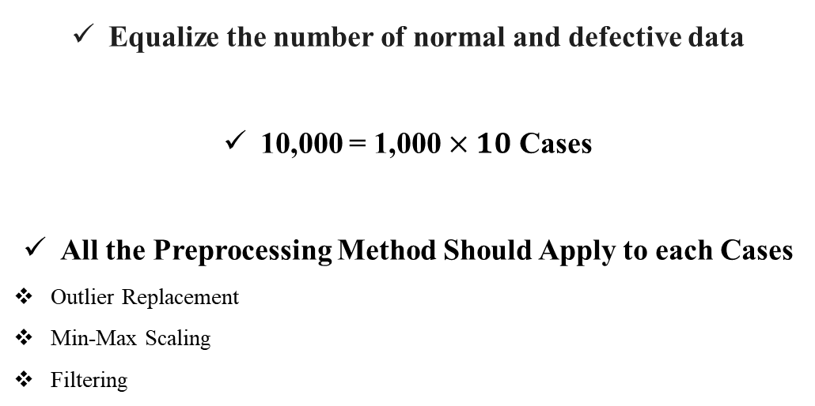
3. Data Preprocessing
1. Selection
Fault type 0: Normal (16,000 entries) → (10,000 entries)
Fault type 1: Rich mixture - High Pressure, Incorrect Sensor, etc. (10,988 entries) → (10,000 entries)
Fault type 2: Lean mixture – Low Pressure, Incorrect Sensor, etc. (15,000 entries) → (10,000 entries)
Fault type 3: Low Voltage – Worn Spark, Defective Coil, etc. (14,001 entries) → (10,000 entries)
Equalize the number of normal and defective data
10,000 = 1,000 $×10$ Cases
All the Preprocessing Method Should Apply to each Cases
Outlier Replacement
Min-Max Scaling
Filtering
Case 1
Case 10
Case 2

Slide 17
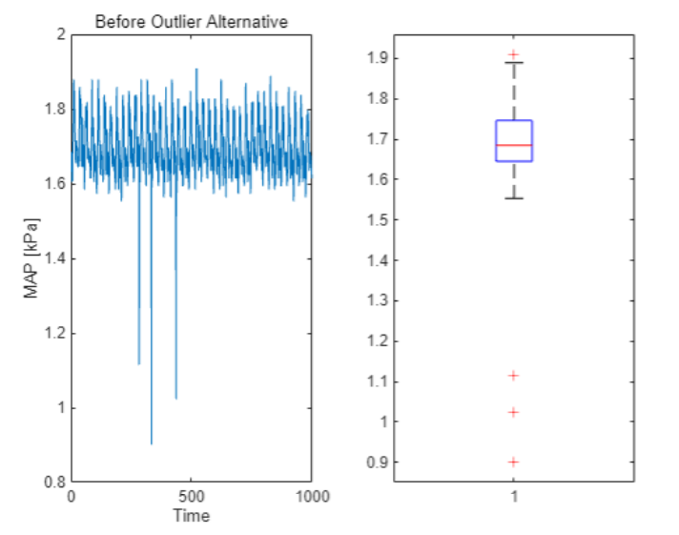
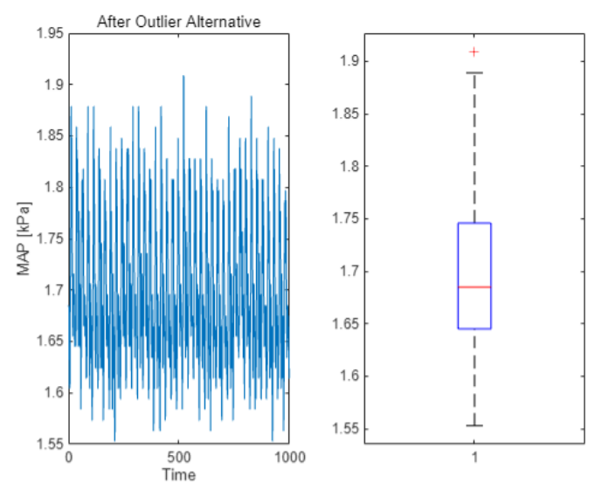
3. Data Preprocessing
2. Replacement Outlier
Replace the Outliers: Used Linear Interpolation

Slide 18
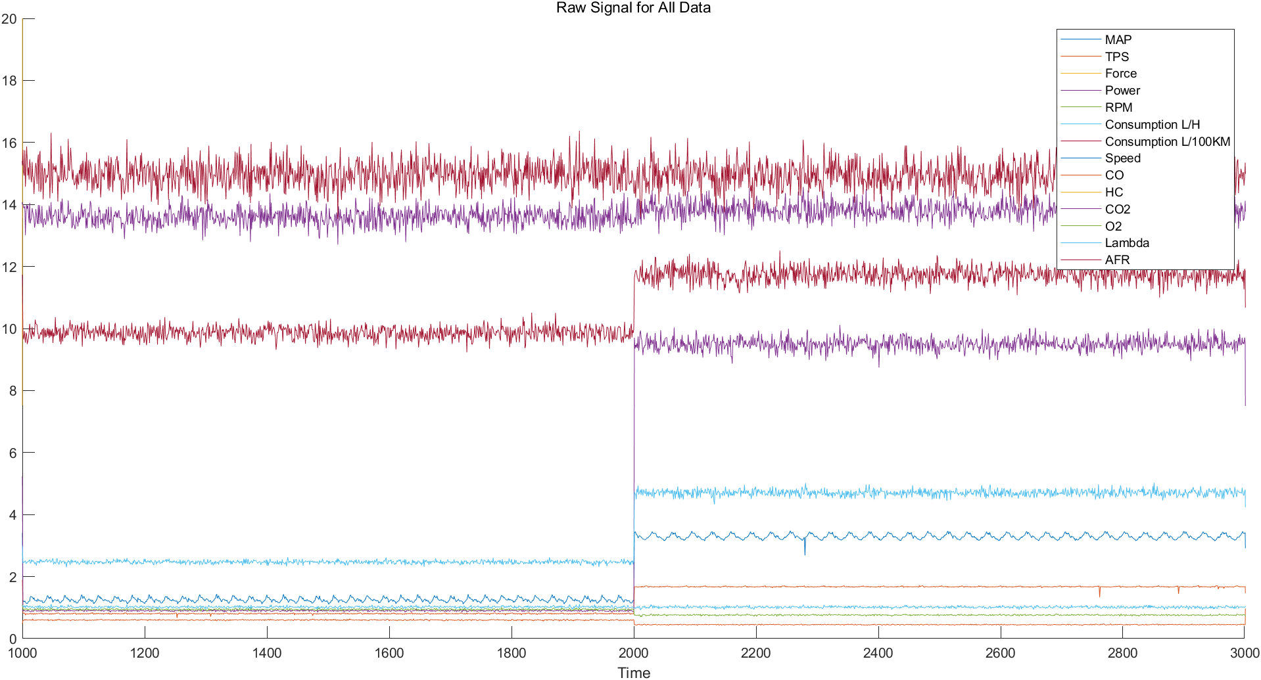
3. Data Preprocessing
3. Min-Max scaling
14 Variables have different magnitude ranges (ex. %, rpm, Pa etc.).
→ Min-Max Scaling [0, 1].

Slide 19
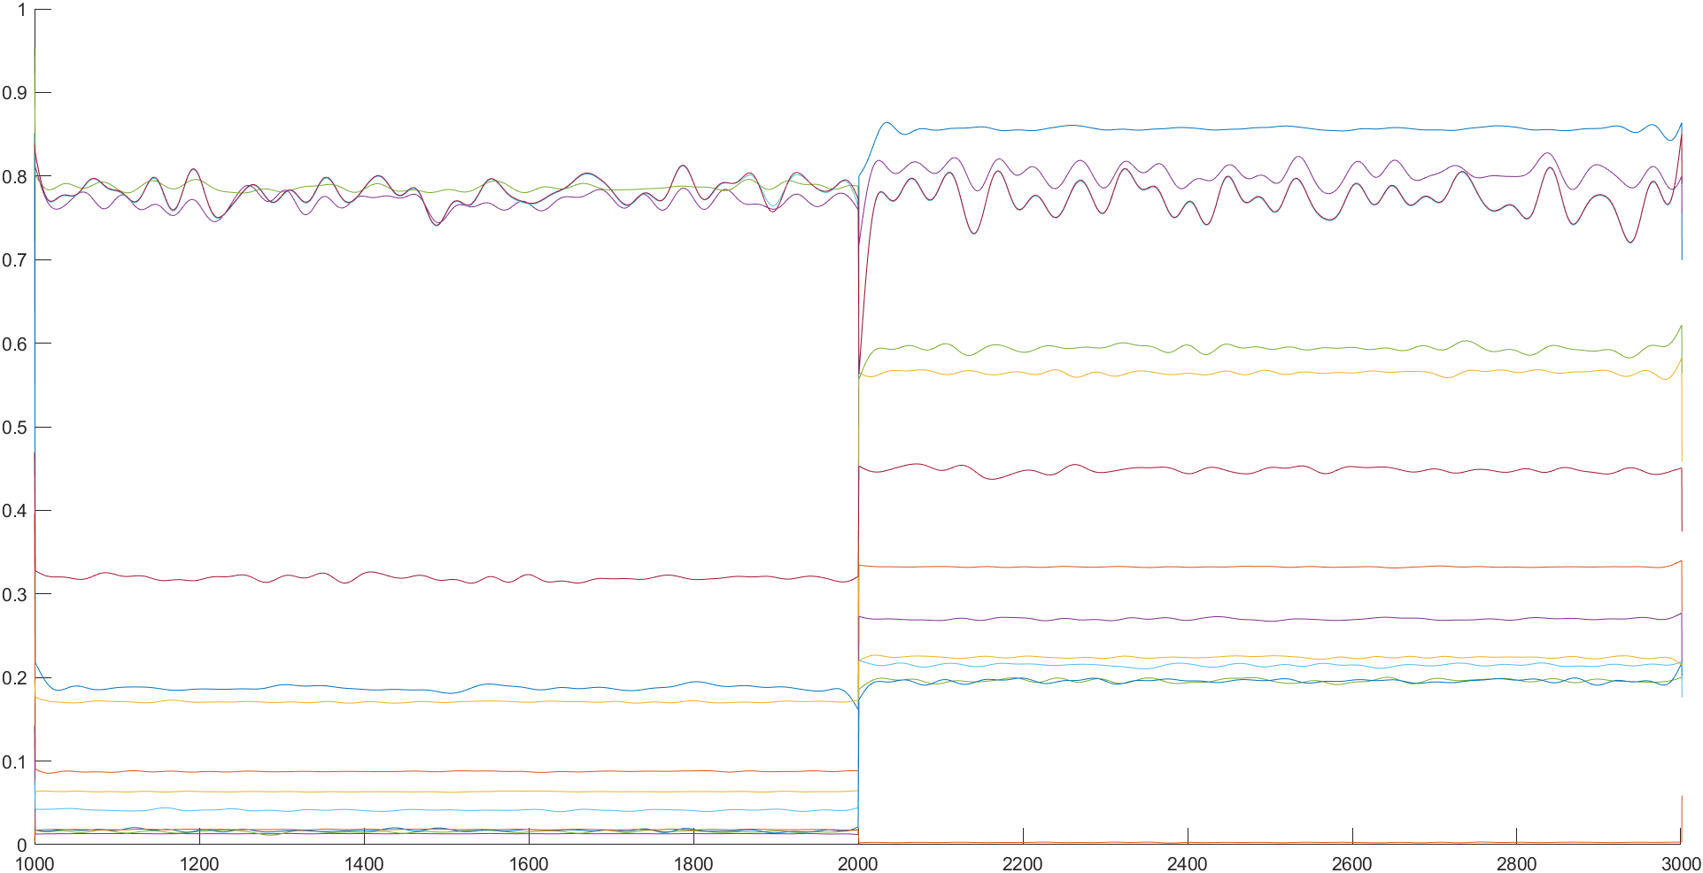
3. Data Preprocessing
4. Butterworth Low Pass Filter
Don’t Focus on Changes Over Time
Focus on the Distribution of Variables
Noise → Distributed with a Large Standard Deviation

Slide 20
4. Classification Model Improvement

Slide 21
3. Data Preprocessing
Test / Train Datasets Split
StratifiedKFold: The Kfold is designed for label datasets with imbalanced distributions.
Fault type 0: Normal (10,000 entries)
Fault type 1: Rich mixture - High Pressure, Incorrect Sensor, etc. (10,000 entries)
Fault type 2: Lean mixture – Low Pressure, Incorrect Sensor, etc. (10,000 entries)
Fault type 3: Low Voltage – Worn Spark, Defective Coil, etc. (10,000 entries)
Choose: (Train: 32,000, Test: 8,000)
The Same Number of Train & Test → Fairness Train

Slide 22
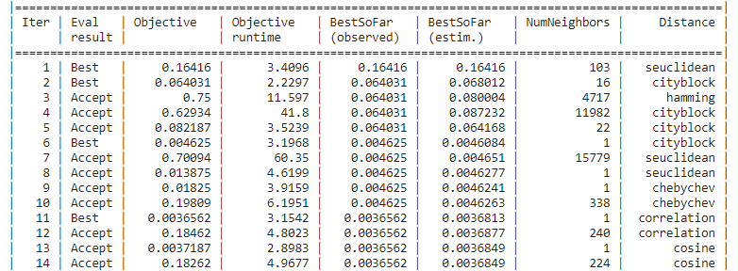
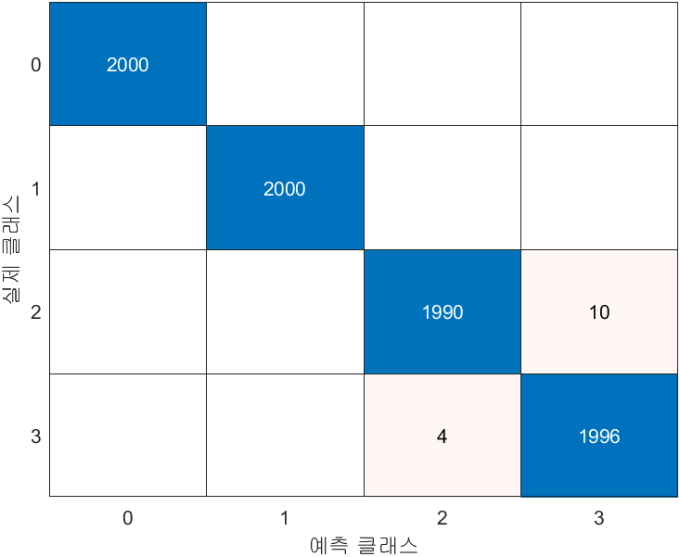
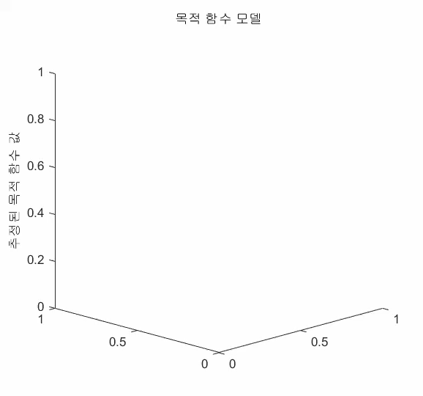
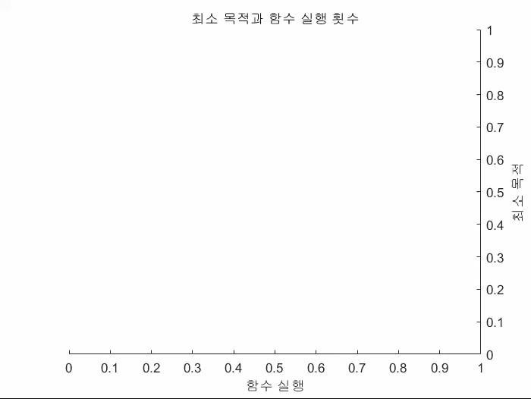
4. Classification Model Improvement
KNN-Number of data: 40,000(Optimization)
Accuracy: 0.99
Precision: 0.99
Recall: 0.99
F1-Score: 0.99

Slide 23
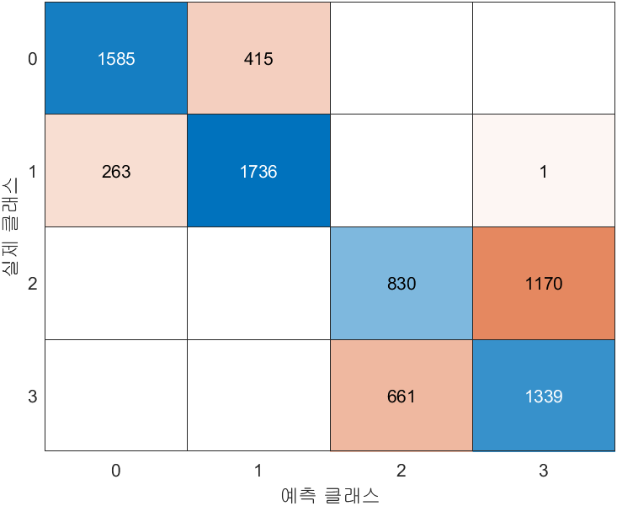

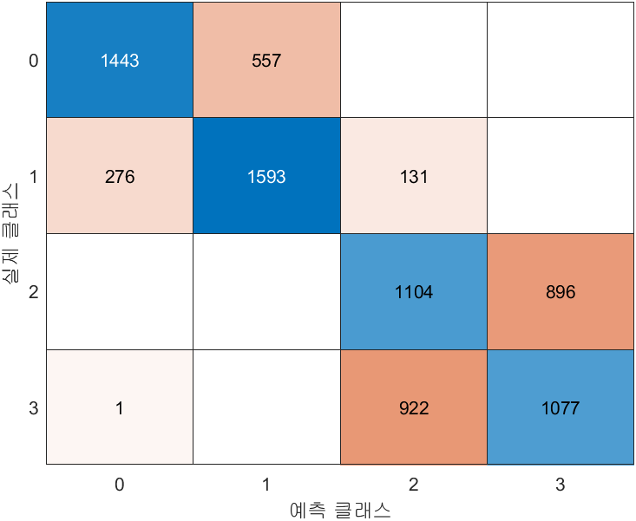
5. Result & Discussion
SVM
TREE
< Final Performance Each Model>
 | SVM | TREE | KNN | LR
Accuracy | 0.69 | 0.97 | 0.99 | 0.65
Precision | 0.69 | 0.97 | 0.99 | 0.65
Recall | 0.69 | 0.97 | 0.99 | 0.66
F1 Score | 0.68 | 0.97 | 0.99 | 0.65
KNN
LR
Notes:
모델의 성능을 향상시키기 위해서 전처리 작업이 중요하다. 우리는 feature extraction, 새로운 머신러닝 모델 시도 등 다양한 방법을 시도하였지만, 결국 전처리를 통해 높은 성능에 도달할 수 있었다. 또한 데이터의 형태를 먼저 파악하고 어떤 작업을 통해 성능을 개선할지도 요구된다.
Preprocessing is crucial for improving model performance. While we explored various methods such as feature extraction and experimenting with new machine learning models, it was ultimately through preprocessing that we achieved higher performance. Additionally, understanding the structure of the data first and determining which preprocessing steps are needed to enhance performance is essential.
모델의 특성: Decision Tree와 KNN은 비선형적인 분류 문제를 다룰 수 있는 특성을 가지고 있으며, SVM과 Logistic Regression은 선형적이거나 고차원 공간에서의 분류 문제에 더 적합합니다. 이 때문에 비선형 데이터에서 SVM과 LR의 성능이 낮을 수 있습니다.
Decision Tree는 섞여있는 데이터에서 하나씩 분류, KNN는 군집 안에 자신이 속한 그룹을 찾아가는 것이다.
SVM은 경계선과의 거리를 이용하여 가중치를 통해 분류하는 것이고, Logistic Regression은 시그모이드, 또는 로그 함수의 모양으로 분류한다.
A Decision Tree classifies data by splitting it one step at a time. KNN (k-Nearest Neighbors) identifies which group it belongs to by looking for the nearest neighbors within a cluster. SVM (Support Vector Machine) classifies data by using the distance from the boundary and applying weights to determine the classification. Logistic Regression classifies data using a sigmoid function, or sometimes a log function, to separate the data.
Model Characteristics: Decision Tree and KNN possess the ability to handle nonlinear classification problems, while SVM and Logistic Regression are more suited for linear or high-dimensional space classification tasks. This is why SVM and LR may exhibit lower performance on nonlinear data.

Slide 24
5. Result & Discussion

Slide 25
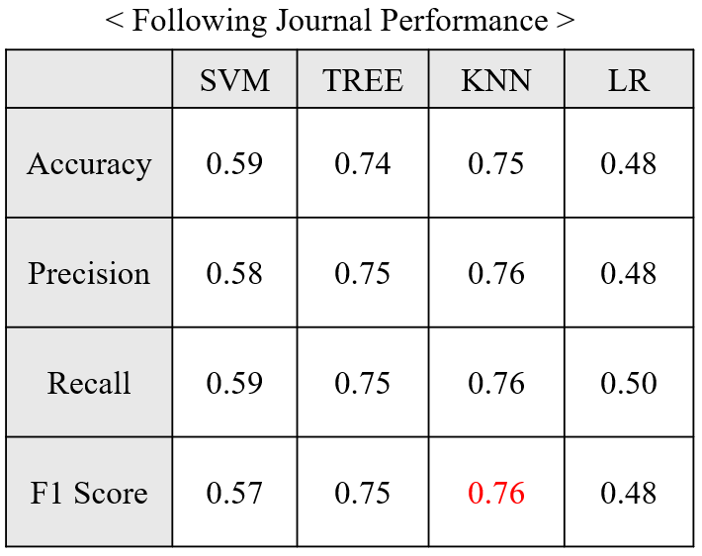
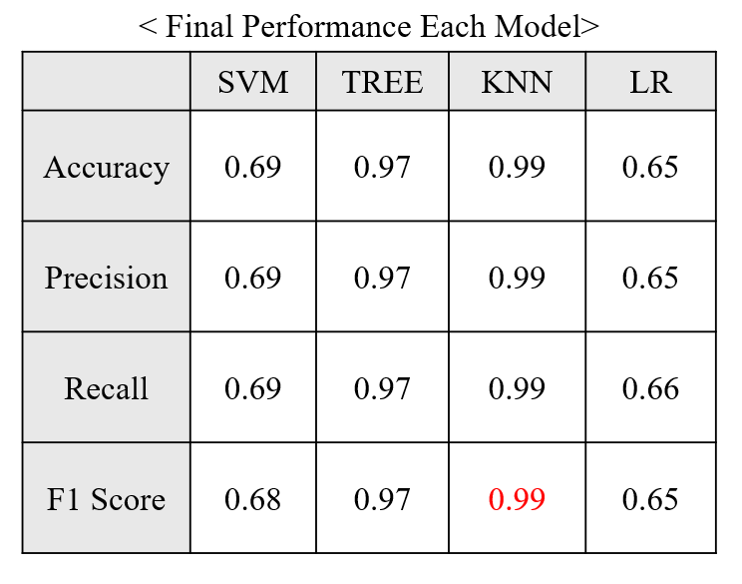
5. Result & Discussion
76% → 99% (+23%)
Why KNN & Tree Model has Better Performance than others?
KNN has benefited from having variables with similar patterns
Decision Tree(clear classification rules) has advantage in multiple input
KNN & Tree is vulnerable to noise → Butterworth Lowpass Filter

Slide 26
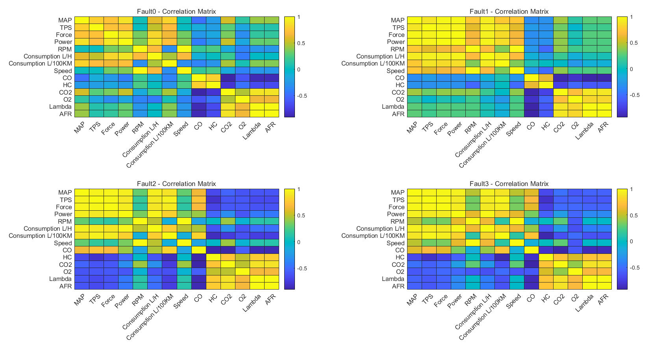
5. Result & Discussion
Fault2 & Fault3 Show Similar Tendency.→ Difficult to Classification
AFR, CO, CO2, O2 Correlation: Exhaust, Combustion Process.(Fault3)
MAP, TPS, Power, Force Correlation: Engine Intake System. (Fault3)

Slide 27
6. Additional Research - BOSCH Datasets

Slide 28
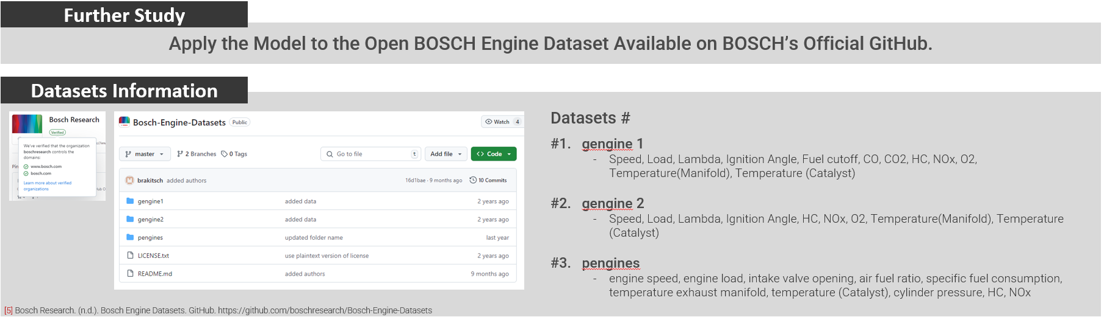
5. Additional Research
*Unlabeled about Engine Fault
Strategy:
Using regression techniques, output variables can be predicted from input variables.
In other words, physical data that is easily obtainable, such as engine speed, load, fuel cutoff, etc., can be used to predict CO, CO2, HC, etc., as well as temperatures within the engine manifold — data that typically requires a gas analyzer.
This allows for identifying types of engine faults using only easily accessible data and the predicted output variables.

Slide 29
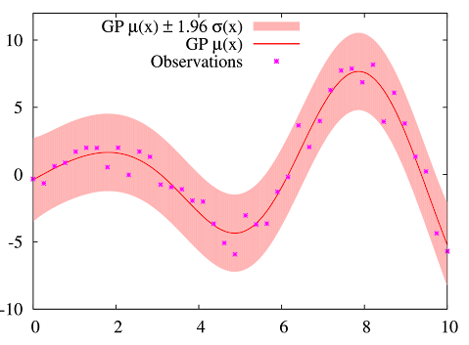
5. Additional Research
Fuel Cutoff Data Preprocessing
Train/Test Data Split
Box Plot & Outlier Replacement
GPR
Linear
Regression
Random Forest
SVR
MOGP
*Python
Noise Reduction
(Butterworth Low pass filter)
* <Gaussian Process Regression>
Non-parametric, probabilistic regression method that learns the distribution of functions.
Measures the correlation (similarity) between data points.
Data points that are closer to each other have higher similarity.
Provides uncertainty estimates for the data, allowing evaluation of predictions along with confidence intervals.
Min-Max Scaling
Add Fuel Cutoff Data
Down Sampling

Slide 30
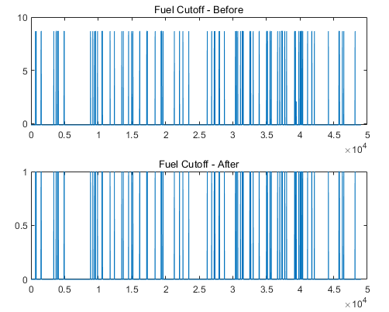
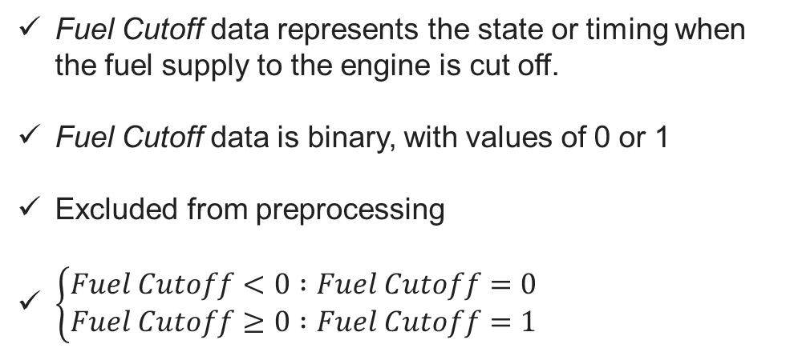
5. Additional Research
Fuel Cutoff Data Preprocessing
Box Plot & Outlier Replacement
Noise Reduction
(Butterworth Low pass filter)
Fuel Cutoff data represents the state or timing when the fuel supply to the engine is cut off.
Fuel Cutoff data is binary, with values of 0 or 1
Excluded from preprocessing
$\left\{\begin{aligned}Fuel Cutoff<0 :Fuel Cutoff=0 \\ Fuel Cutoff≥0 :Fuel Cutoff=1 \end{aligned}\right.$
Min-Max Scaling
Add Fuel Cutoff Data
Down Sampling

Slide 31
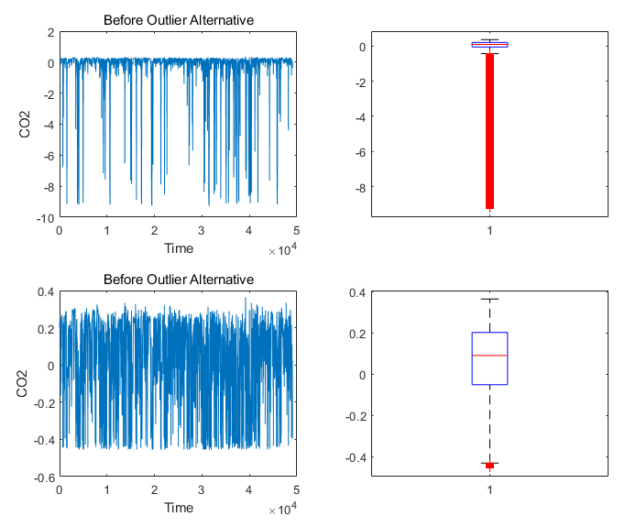
5. Additional Research
Fuel Cutoff Data Preprocessing
Box Plot & Outlier Replacement
Noise Reduction
(Butterworth Low pass filter)
Min-Max Scaling
Linear interpolation was used to replace outliers.
A box plot was utilized to assess the improvement in outlier reduction.
Add Fuel Cutoff Data
Down Sampling

Slide 32
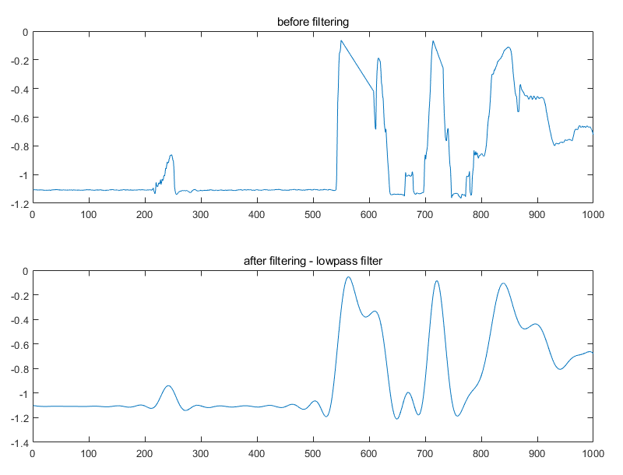
5. Additional Research
Fuel Cutoff Data Preprocessing
Box Plot & Outlier Replacement
Noise Reduction
(Butterworth Low pass filter)
Min-Max Scaling
A Butterworth low-pass filter was used to manage noise introduced during data acquisition.
Add Fuel Cutoff Data
Down Sampling

Slide 33
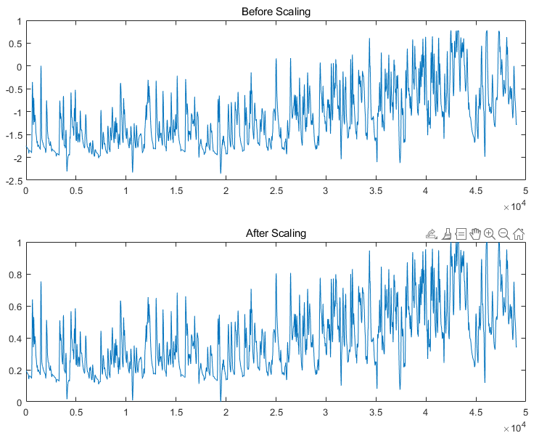
5. Additional Research
Fuel Cutoff Data Preprocessing
Box Plot & Outlier Replacement
Noise Reduction
(Butterworth Low pass filter)
Scaling was applied due to the differing ranges across variables.
Min-Max Scaling was used to normalize the data within a [0, 1] range.
Min-Max Scaling
Add Fuel Cutoff Data
Down Sampling

Slide 34
5. Additional Research
Fuel Cutoff Data Preprocessing
Box Plot & Outlier Replacement
Noise Reduction
(Butterworth Low pass filter)
Re-importing Preprocessed Cutoff Data from Step 1
The binary data for Fuel Cutoff was not subjected to additional preprocessing.
Min-Max Scaling
Add Fuel Cutoff Data
Down Sampling

Slide 35
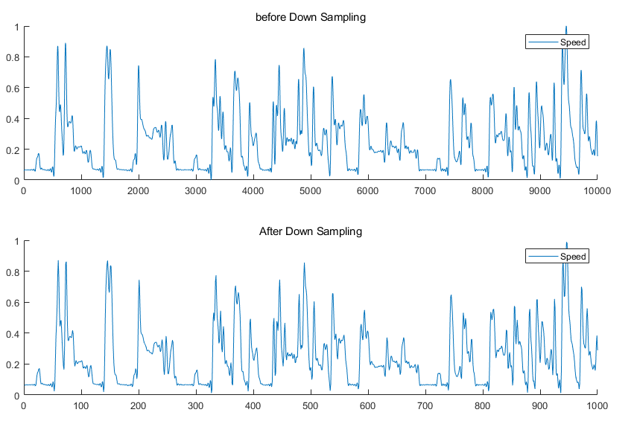
5. Additional Research
Fuel Cutoff Data Preprocessing
Box Plot & Outlier Replacement
Noise Reduction
(Butterworth Low pass filter)
The computational load of Gaussian Process Regression increases exponentially with the number of input data points.
Down-sampling was applied to reduce the data size while preserving trends.
Data Entries: 49007 → 4907
Min-Max Scaling
Add Fuel Cutoff Data
Down Sampling

Slide 36
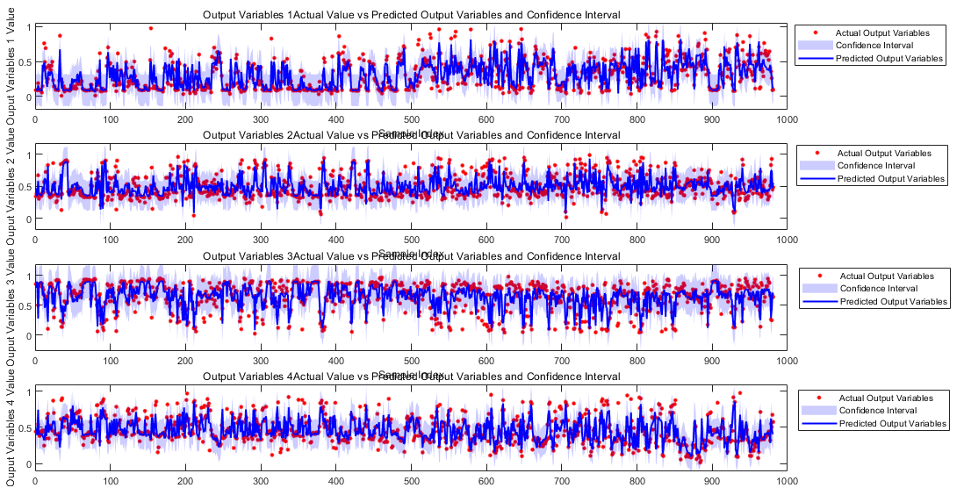
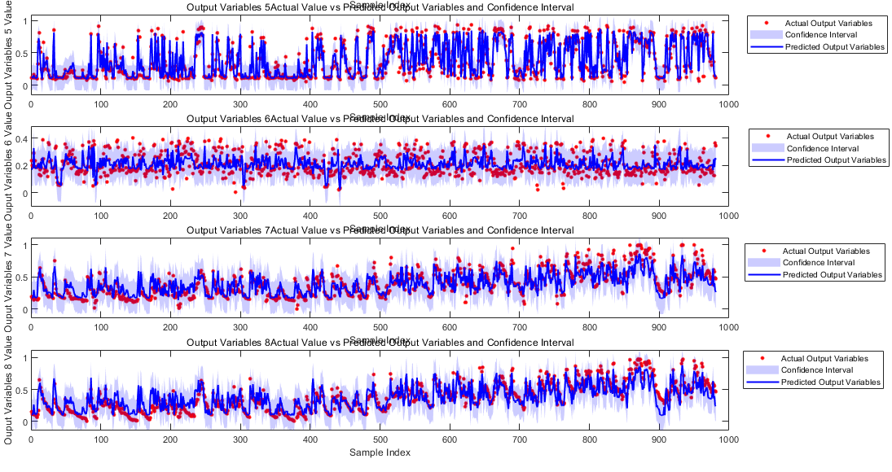
5. Additional Research
Train/Test Data Split
GPR
Linear
Regression
Random Forest
SVR
MOGP
*Python
Since MATLAB lacks Multi-Output Gaussian Process functions, separate GPR models were trained for each output variable.
Confidence intervals and predicted values can be compared to actual values.
GPR Average RMSE = 0.1174

Slide 37
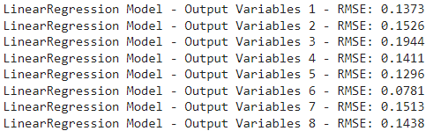
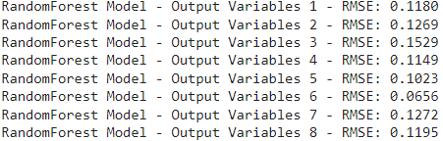
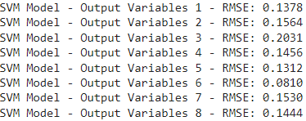
5. Additional Research
Train/Test Data Split
GPR
Linear
Regression
Random Forest
SVR
MOGP
*Python
Three additional regression models were trained to compare performance with Gaussian Process Regression (GPR).
Linear Regression Average RMSE = 0.1410
Random Forest Regression Average RMSE = 0.1159
SVR Average RMSE = 0.1441

Slide 38
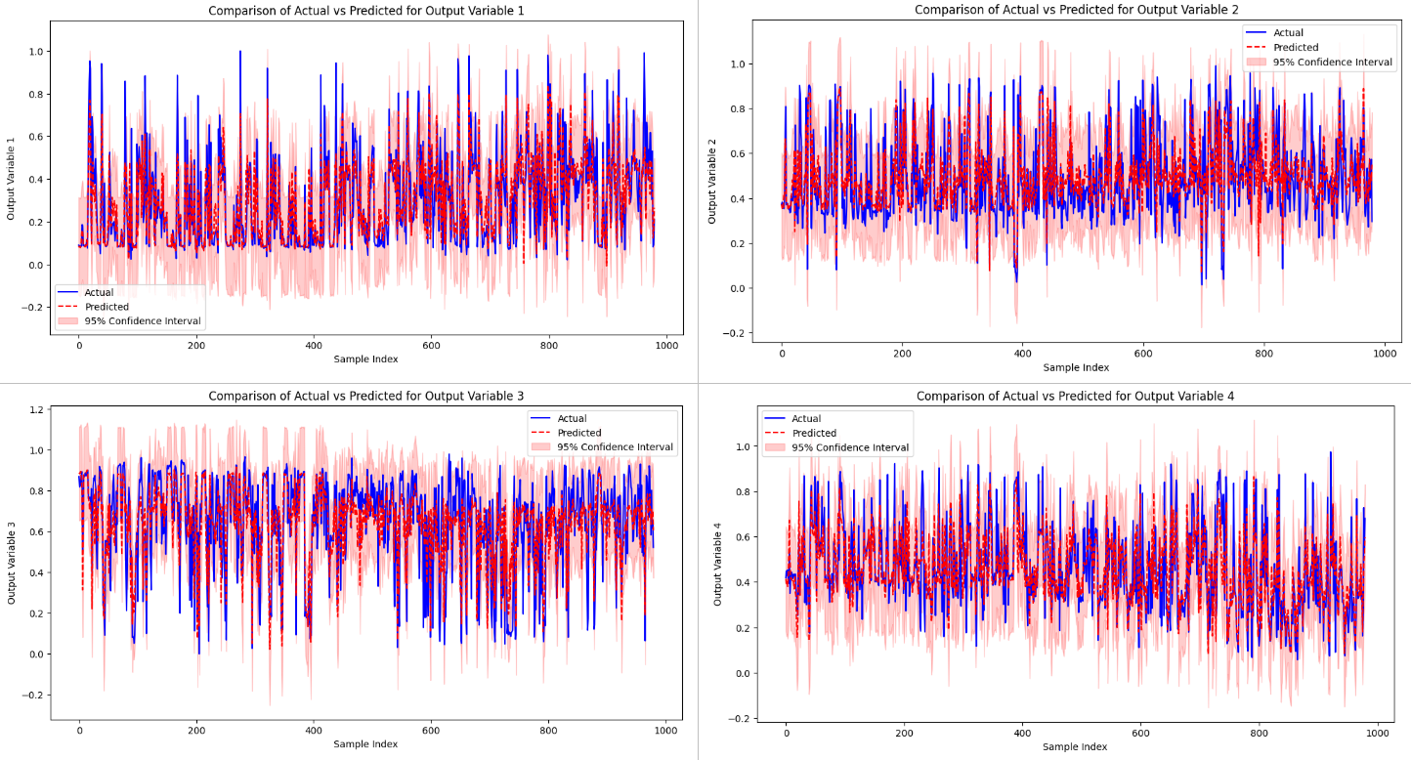
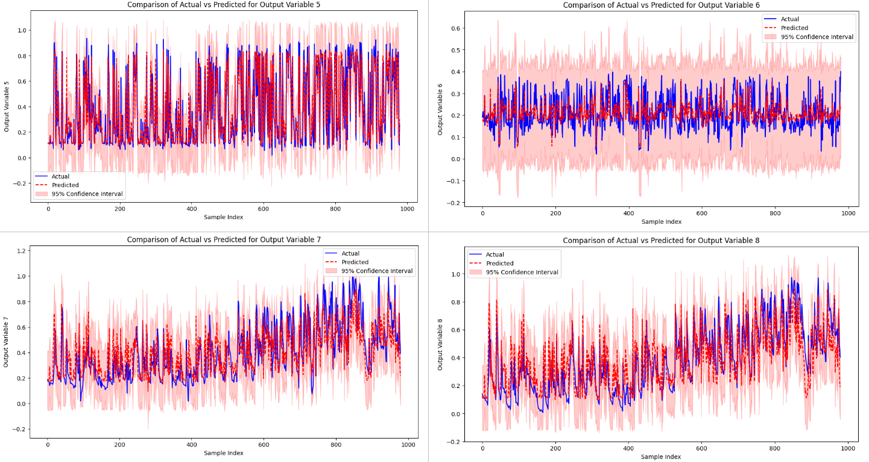
5. Additional Research
Train/Test Data Split
GPR
Linear
Regression
Random Forest
SVR
MOGP
*Python
MATLAB does not support Multi-Output Gaussian Process (MOGP), but Python does through the GPy module.
MOGP Average RMSE = 0.1188

Slide 39
5. Additional Research – Result & Discussion
 | GPR | Linear Regression | Random Forest | SVR | MOGP
RMSE | 0.1174 | 0.1405 | 0.1180 | 0.1424 | 0.1188
Advantages of GPR/MOGP Over Other Regression Models
Interdependency Modeling: MOGP captures relationships between multiple output variables, improving accuracy.
Uncertainty Estimation: Provides confidence intervals, enhancing reliability in applications like fault detection.
Non-Linear Capability: GPR’s kernel-based approach effectively models complex, non-linear relationships.
Computational Considerations of GPR/MOGP
High Cost: GPR/MOGP is computationally intensive due to the large kernel matrix.
Benefit of Large Data: More data improves accuracy and reliability but increases computational load.
Conclusion
GPR/MOGP’s advantages in accuracy and uncertainty estimation make it highly suitable for complex, interdependent datasets like BOSCH Engine Datasets.
Adaption Output Variables must be measured with expensive equipment such as a Gas Analyzer, but if Output Variables can be accurately estimated with Input Variables, the status or defect of the engine can be identified using the data.

Slide 40
Reference
[1] Vergara, M., Ramos, L., Rivera-Campoverde, N. D., & Rivas-Echeverría, F. (2023). Enginefaultdb: a novel dataset for automotive engine fault classification and baseline results. IEEE Access, 11, 126155-126171.
[2] Li, C. Y., Rakitsch, B., & Zimmer, C. (2022, May). Safe active learning for multi-output gaussian processes. In International Conference on Artificial Intelligence and Statistics (pp. 4512-4551). PMLR.

